Slide 1
ME 233 Advance Control II
Lecture 13
Stationary
Linear Quadratic Gaussian (LQG)
Optimal Control
(ME233 Class Notes pp.LQG1-LQG7)
TexPoint fonts used in EMF.
Read the TexPoint manual before you delete this box.: AAAAAAAAAA

Slide 2
Outline
Stationary LQG
Relationship to H₂ optimal control

Slide 3
Stationary random inputs
Linear system contaminated by noise:
Assume that both
w(k) and v(k) are WSS, zero-mean

Slide 4
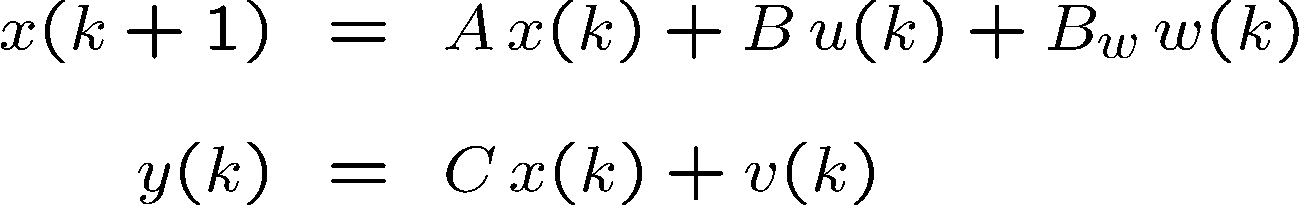
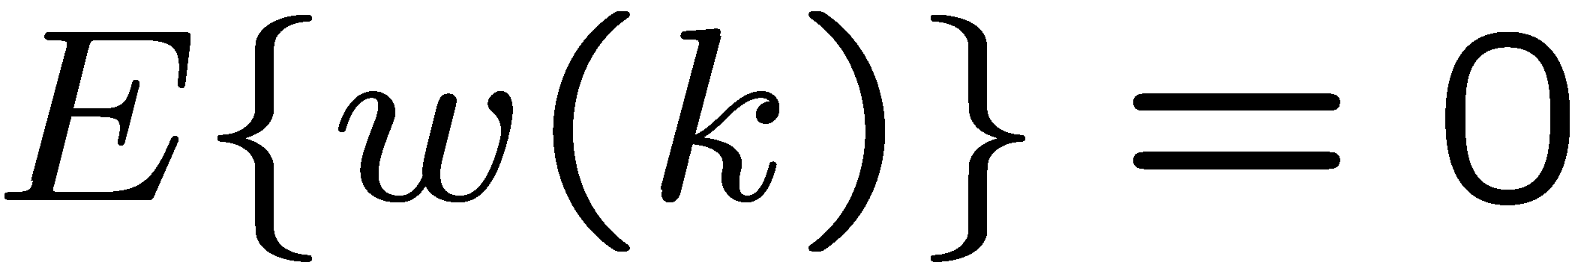
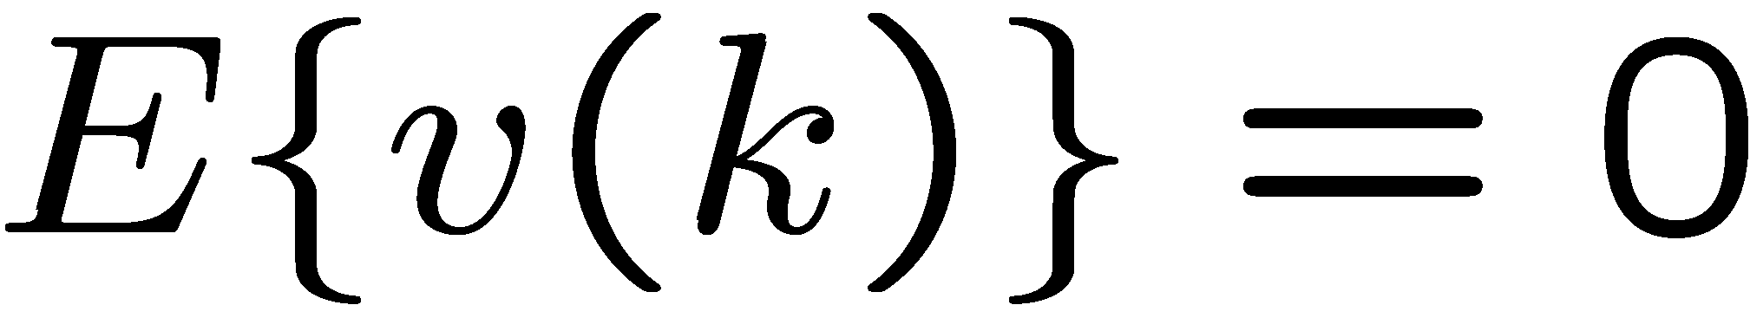
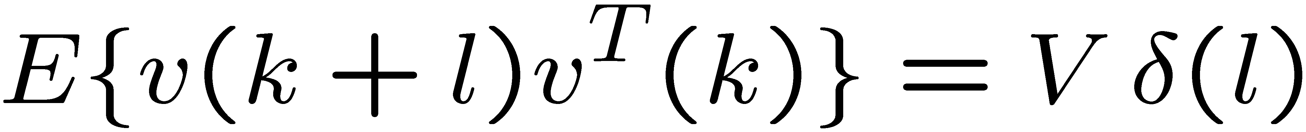
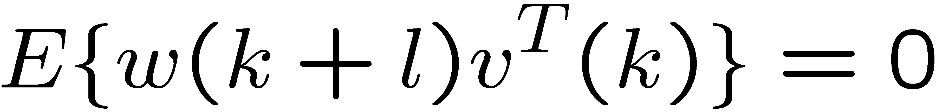
Stationary LQG
We want to regulate the state
under
WSS zero-mean white Gaussian
Noise

Slide 5
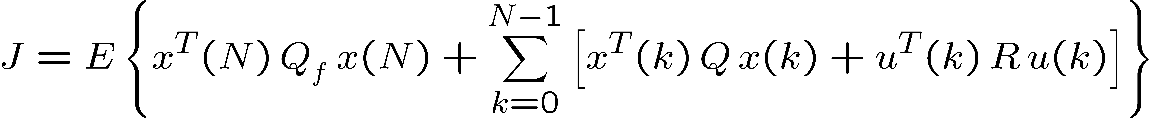
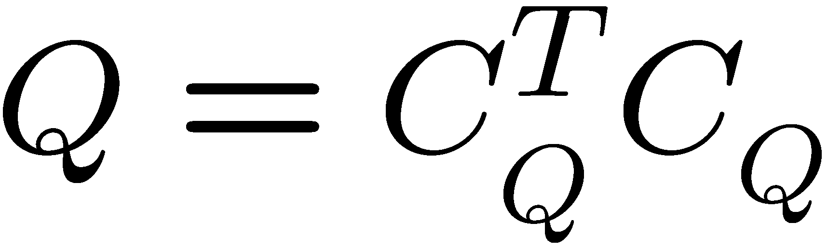
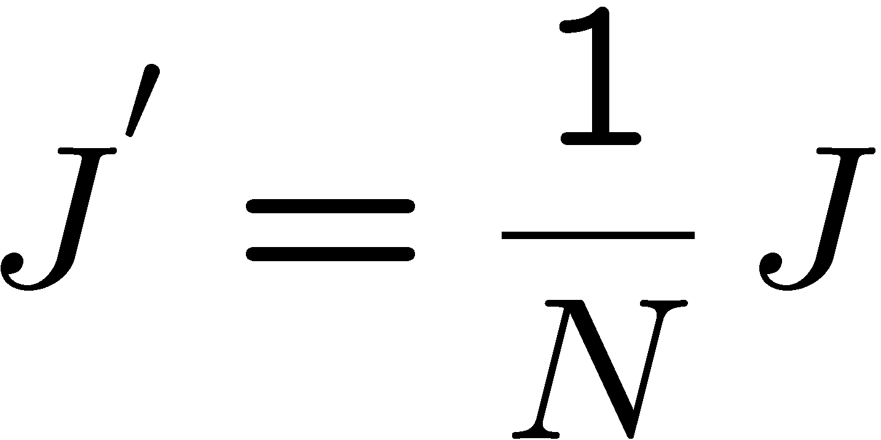
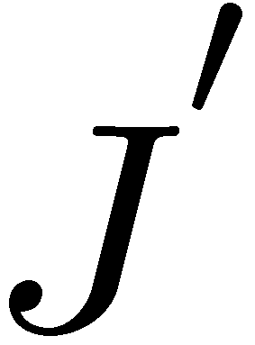
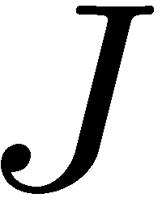
Stationary LQG
Define the “incremental” cost
The control that minimizes also minimizes

Slide 6
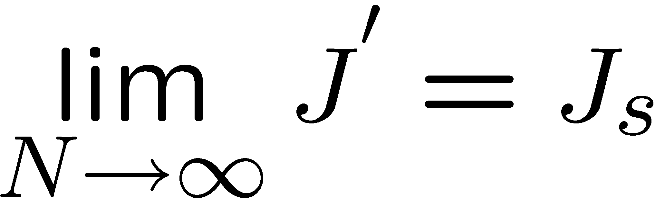
Stationary LQG
“Incremental” cost:
Under the stationarity assumptions:

Slide 7
Stationary LQG
Obtain the optimal control that minimizes:
under
w(k) and v(k) are WSS

Slide 8
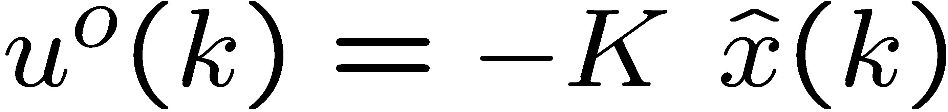
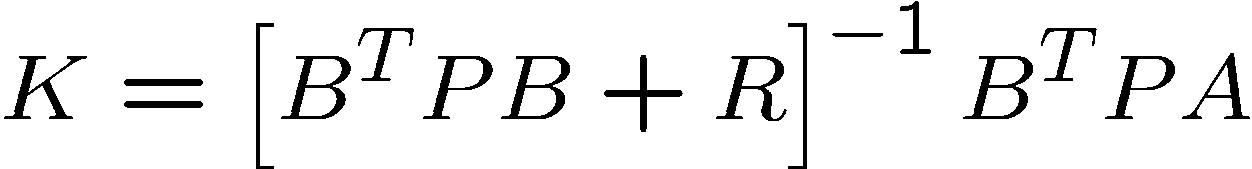
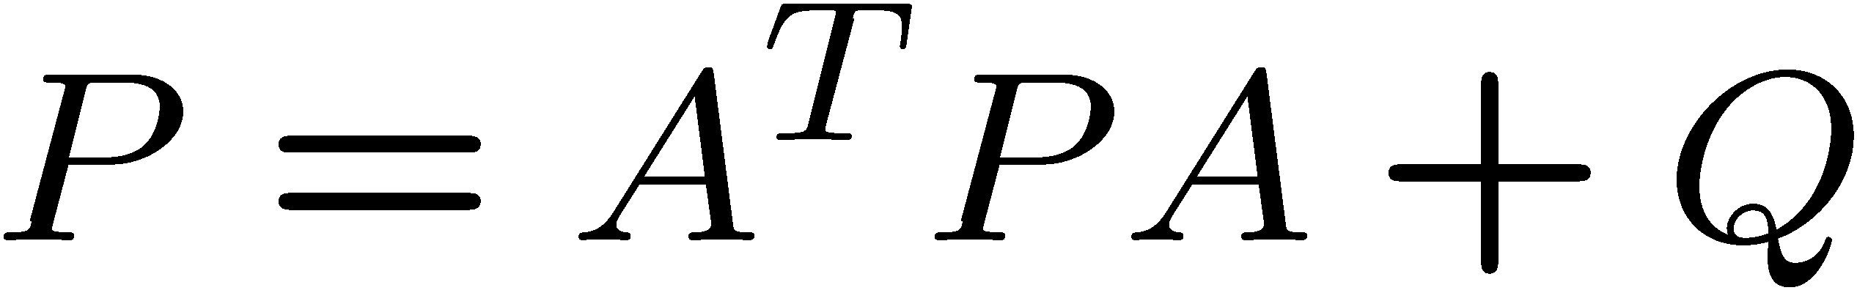
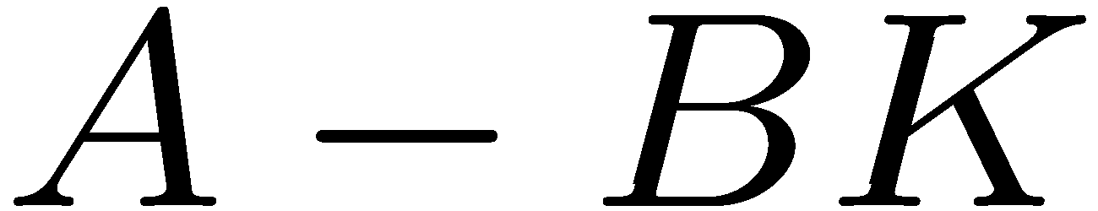
Optimal stationary LQG
Theorem:
a) The optimal control is given by
Such that
is Schur
Standard deterministic infinite-horizon LQR solution!

Slide 9
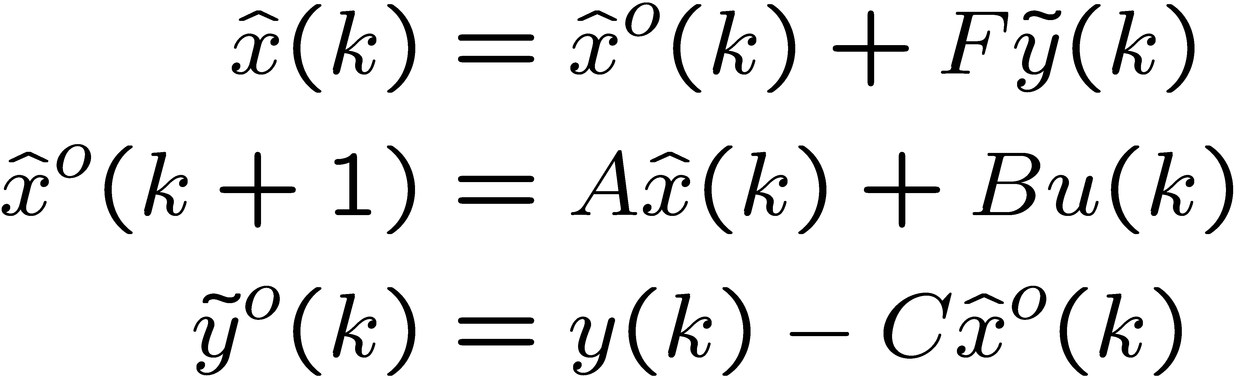
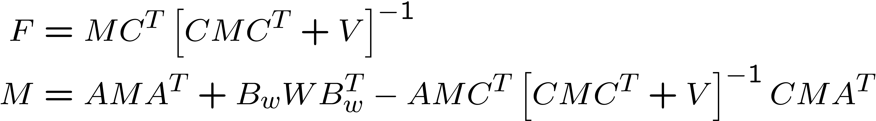
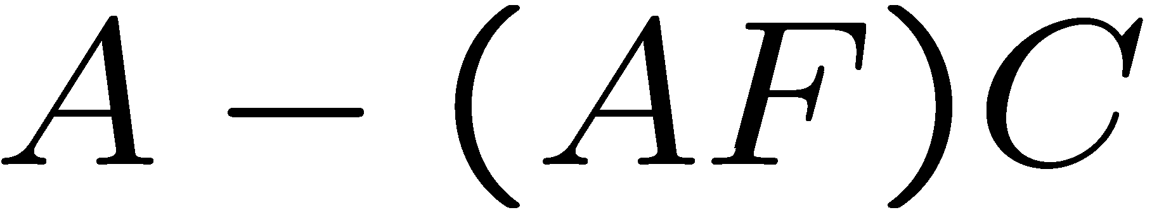
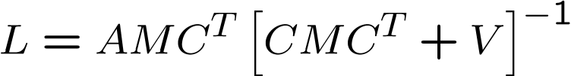
Optimal stationary LQG
Theorem (cont’d):
A-posteriori state observer structure:
Such that
is Schur

Slide 10
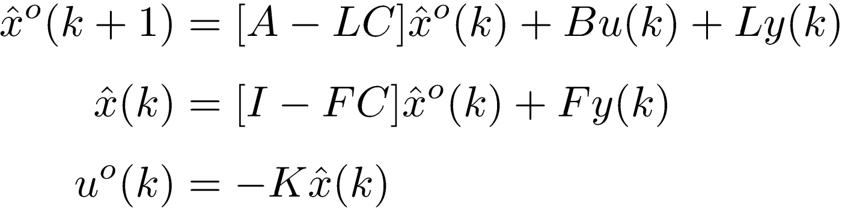


State space form of LQG controller
Kalman filter
LQR
Eliminating from the expression for uº(k) yields
Plugging this expression for uº(k) into the expression for
yields the state space model on the next slide

Slide 11
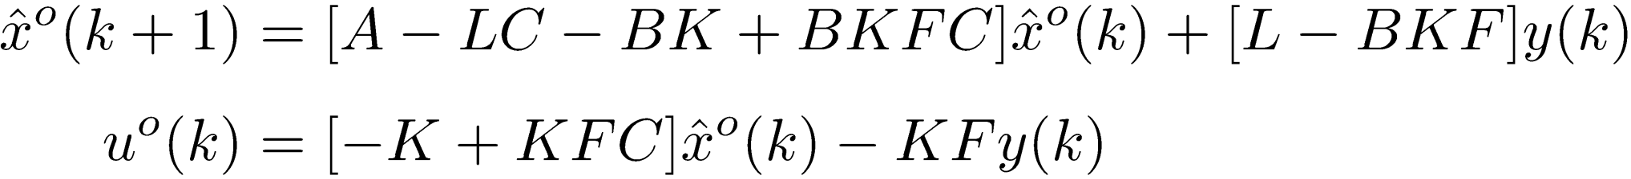
State space form of LQG controller
K is the standard deterministic LQR gain
F and L are the standard Kalman filter gains
The closed-loop poles are the eigenvalues of
A – BK and the eigenvalues of A – LC

Slide 12
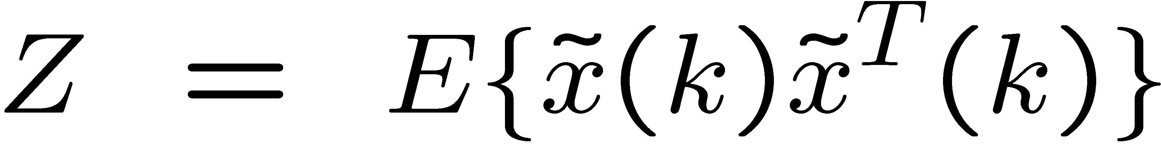
Optimal stationary LQG
Theorem (cont’d):
b) The optimal cost is
(see the derivation of this result at the end)

Slide 13
Conditions for existence
Existence of infinite-horizon LQR solution
  (A,B) stabilizable
  (C_{Q} ,A) has no unobservable modes on the unit circle
Existence of stationary KF solution
  (C,A) detectable
  (A, B_{W}W^{1/2}) has no uncontrollable modes on the unit circle

Slide 14
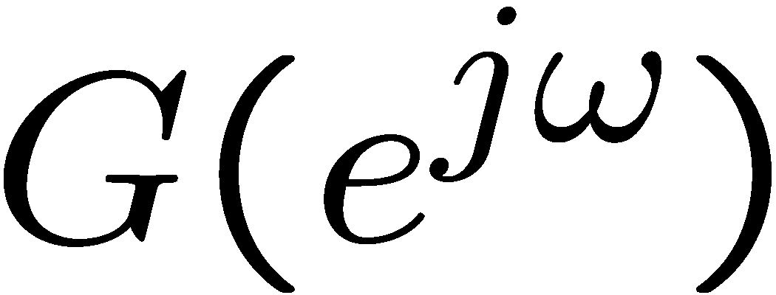
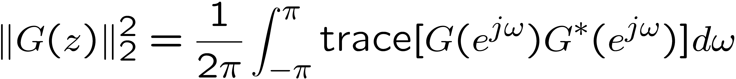
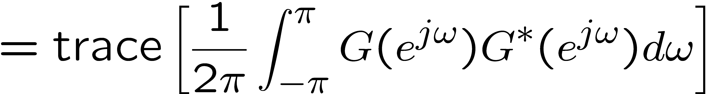
H₂ norm
Let G(z) be a stable discrete-time transfer function
The H₂ norm of G(z) is defined by
Average over frequency
Squared Frobenius norm of

Slide 15
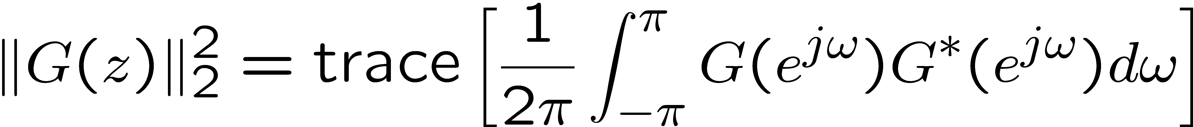
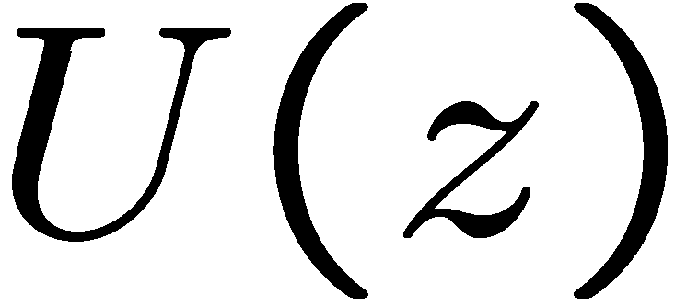
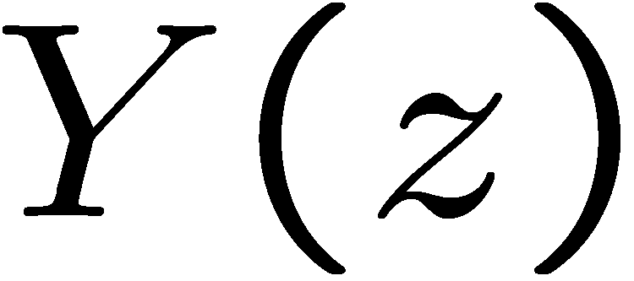


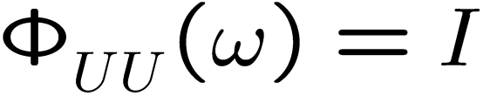

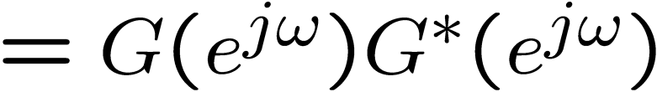
H₂ norm
Suppose U(k) is WSS and zero-mean,
Then

Slide 16
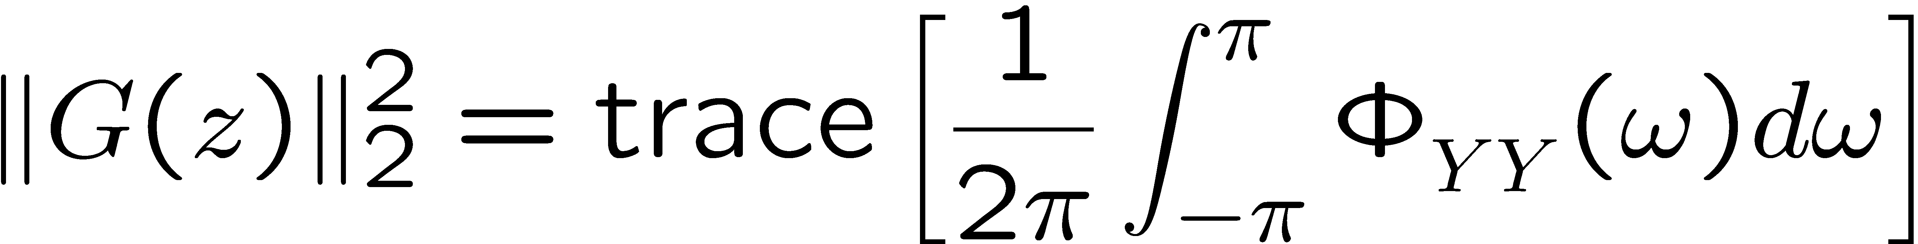
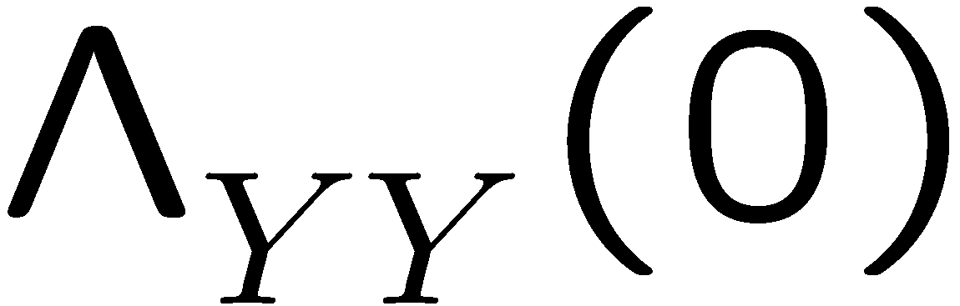
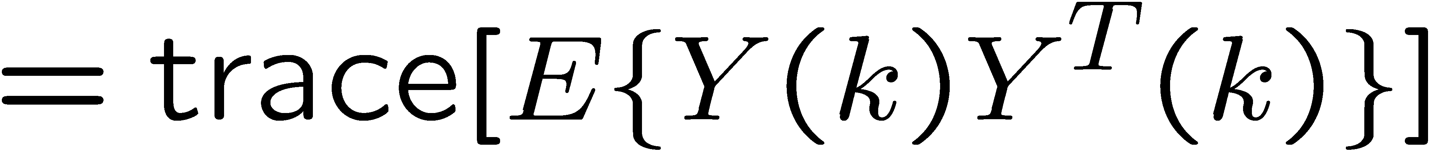
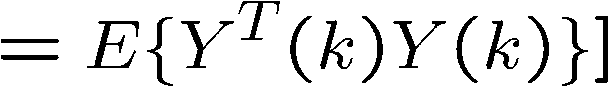

H₂ norm
LQG cost function can be written in this form

Slide 17
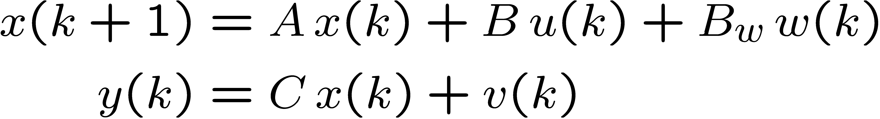
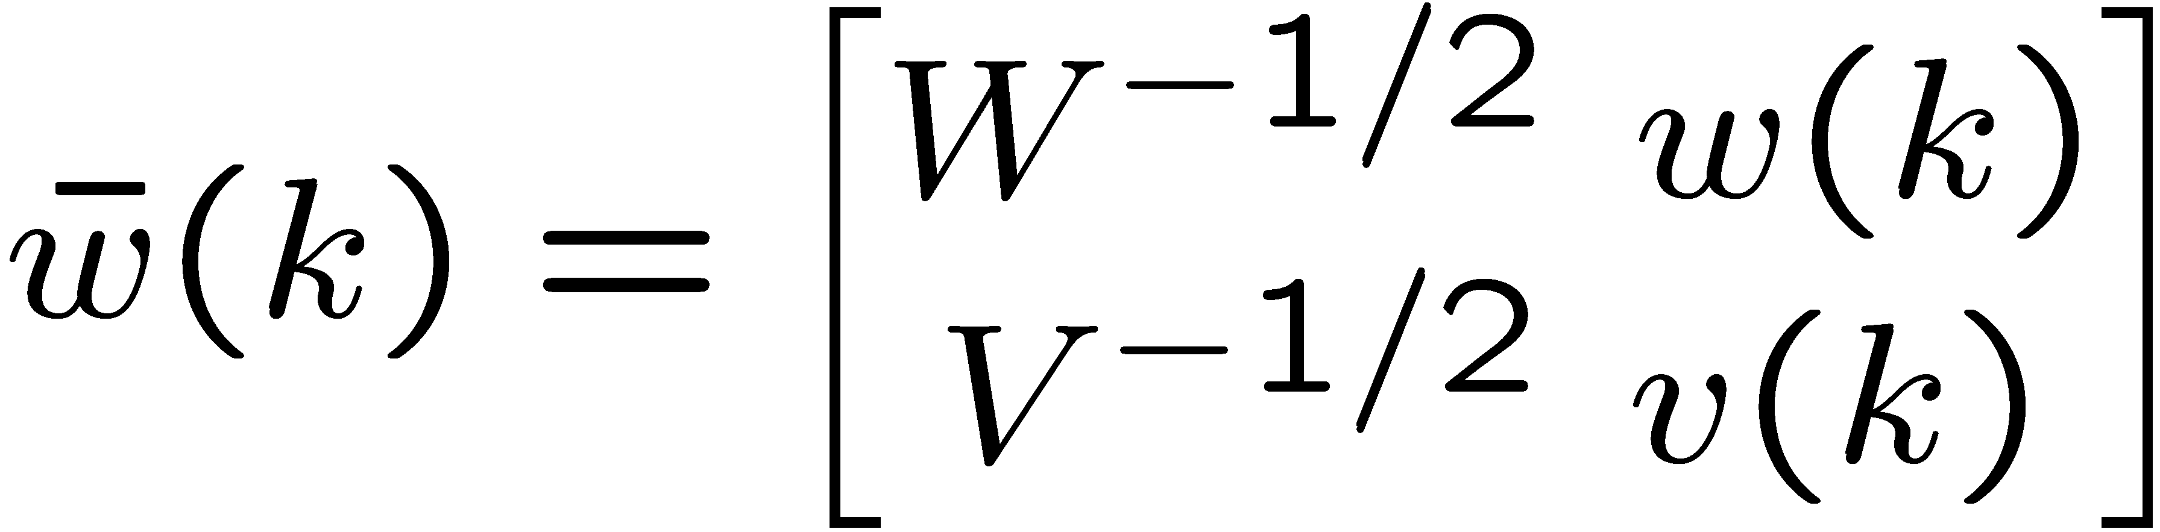
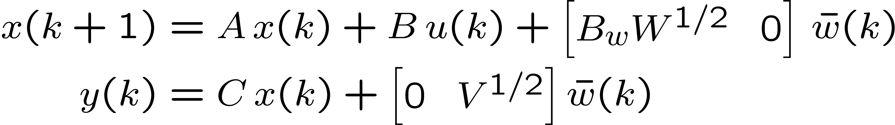
Plant dynamics
define

Slide 18
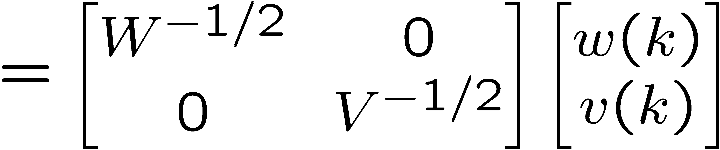
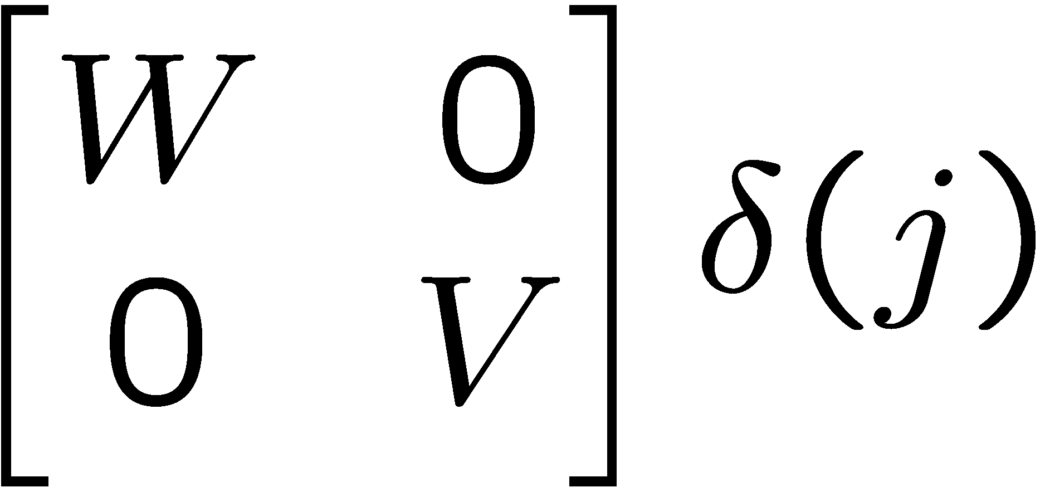
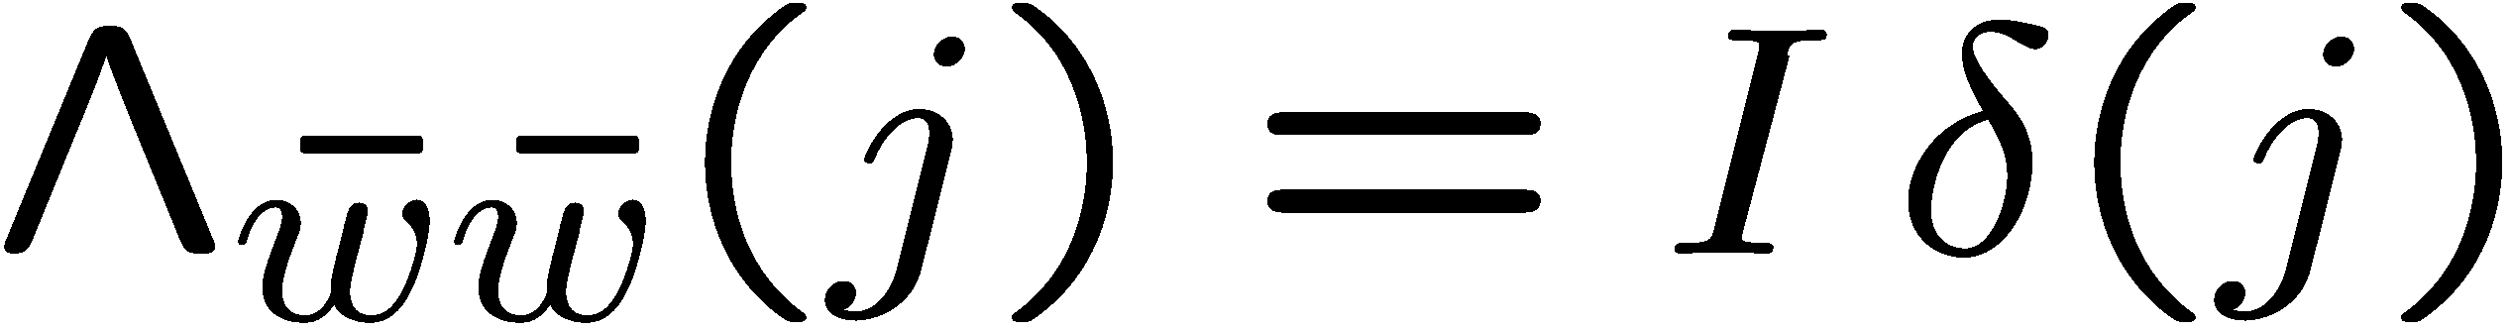
Noise covariance

Slide 19

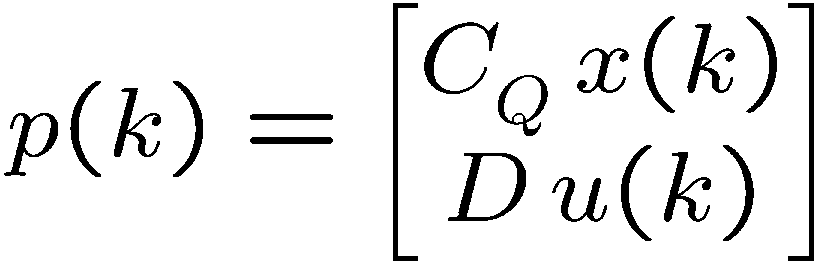
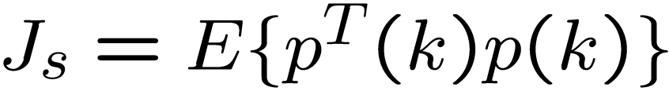
Stationary LQG cost function
factor as
define

Slide 20
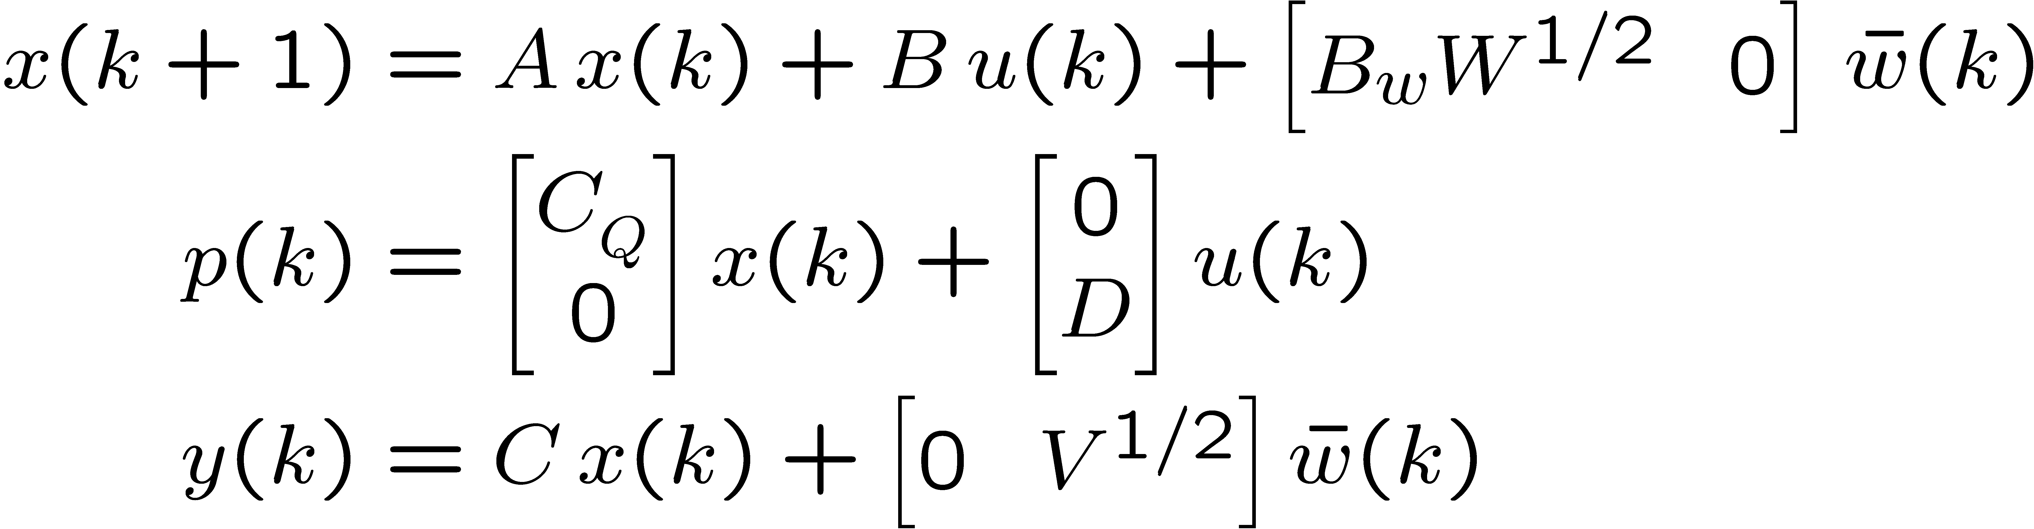
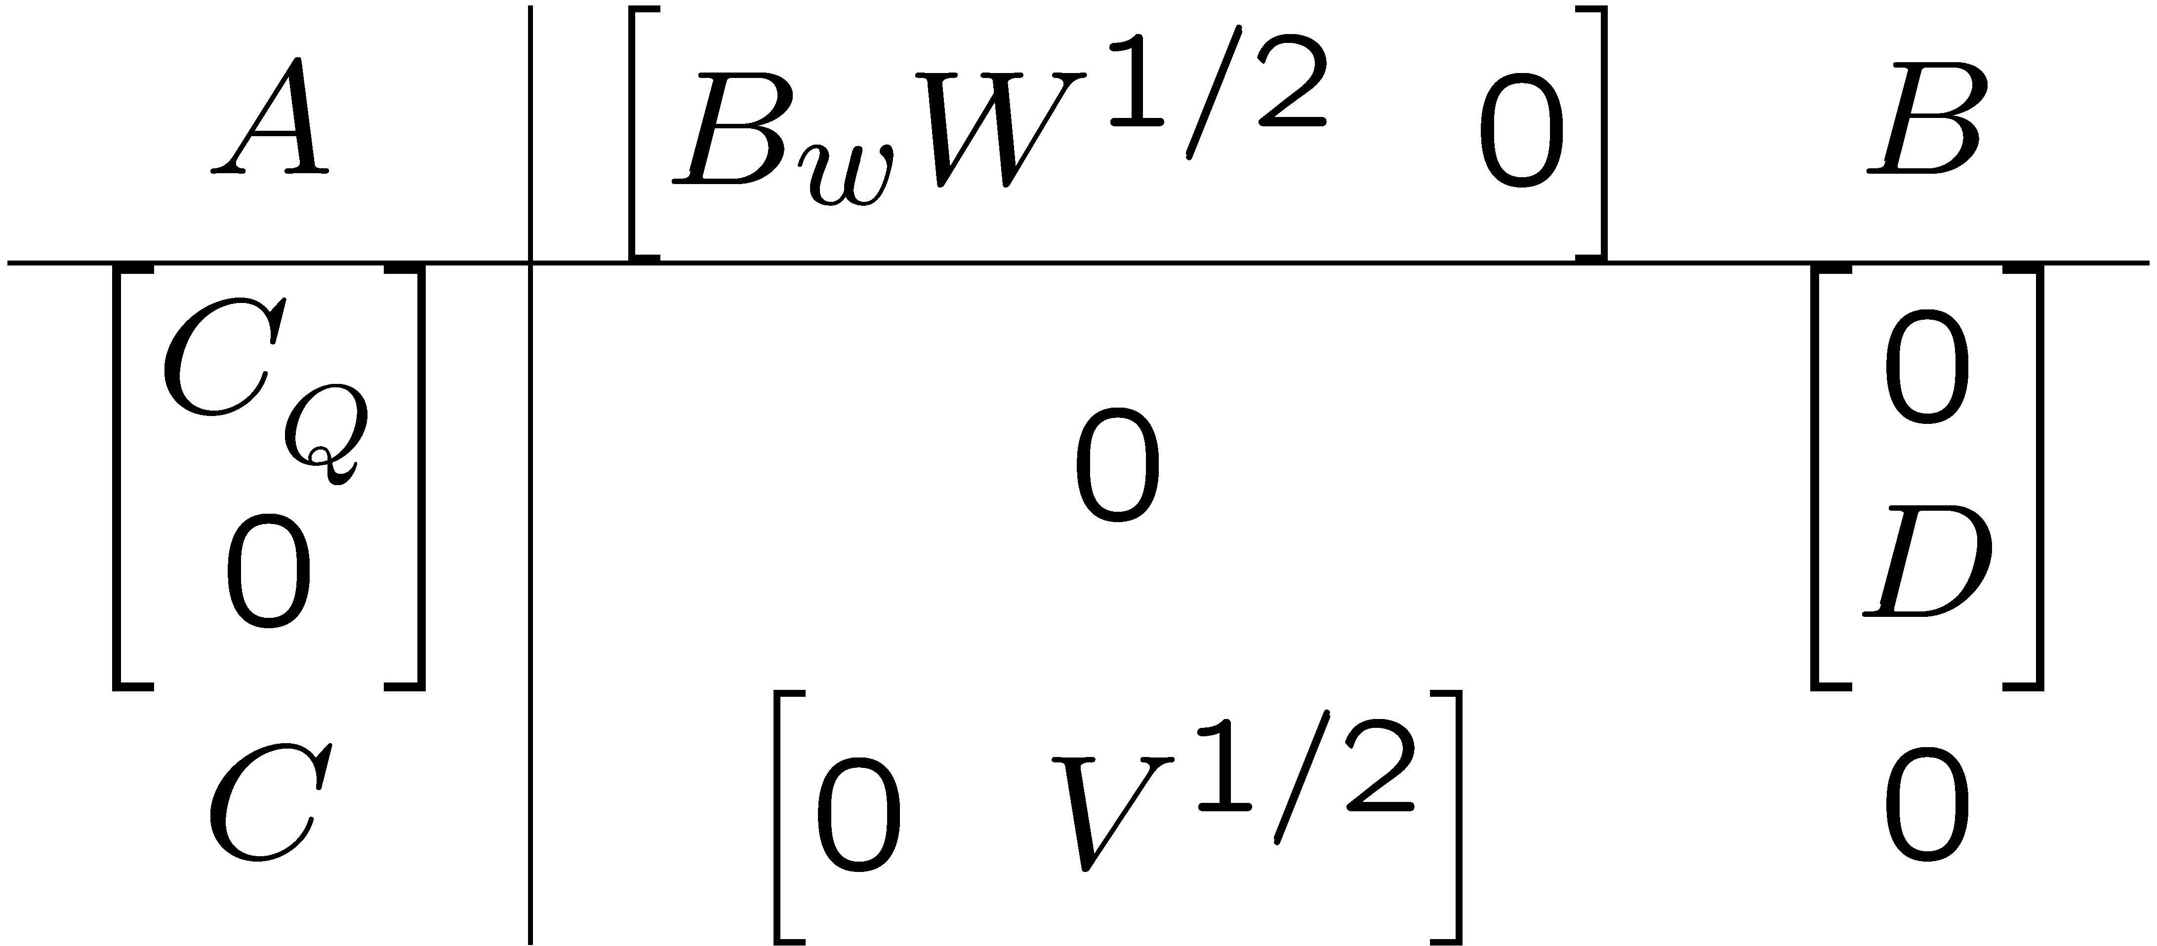




Plant dynamics and LQG cost
Controller

Slide 21

H₂ optimal control problem
For any given stabilizing LTI controller, the squared H₂ norm of the closed-loop system is
  This is equal to the stationary LQG cost!
Minimizing the closed-loop H₂ norm is equivalent to minimizing the stationary LQG cost
Controller

Slide 22
One way to choose an LQG cost function
Each p_{i}(k) is a signal you would like to keep “small” in the closed-loop system
e.g. position error, control effort, actuator displacement
Always include control effort!
Controller

Slide 23
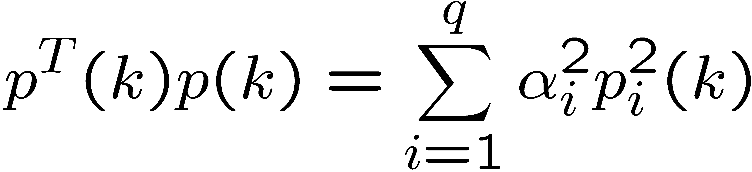
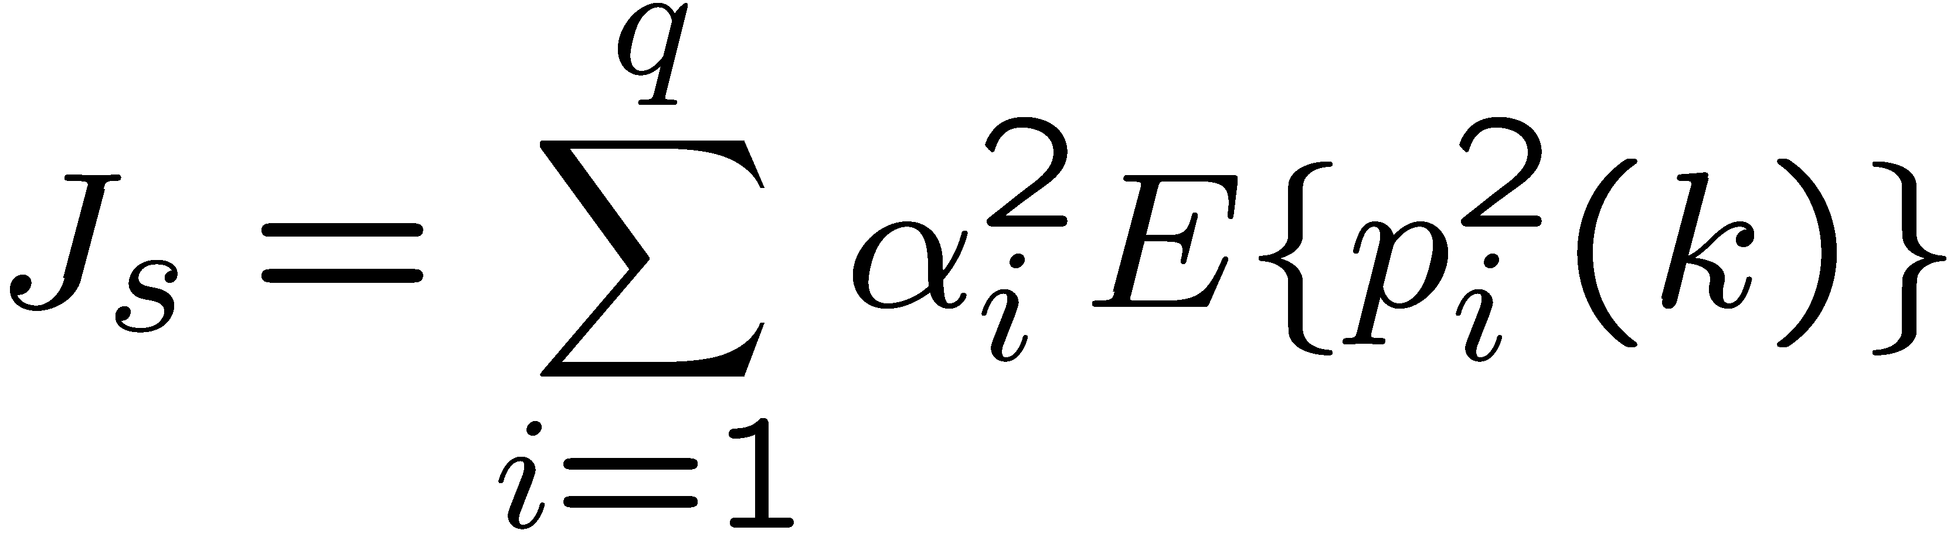



One way to choose an LQG cost function
For any chosen nonzero values of , you can perform an optimal control design and then find the values of
Choose nonzero values of so that the values of are reasonable
This requires iteration

Slide 24
Additional material
(you are not responsible for this)
Derivation of optimal stationary LQG cost

Slide 25
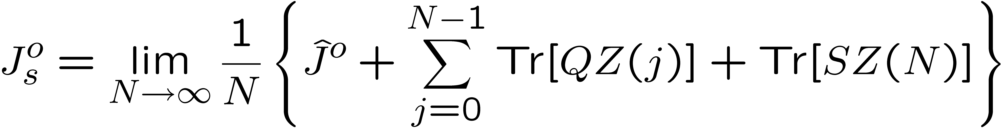
Stationary LQG
Optimal cost (derivation)
The incremental optimal cost is
Thus

Slide 26
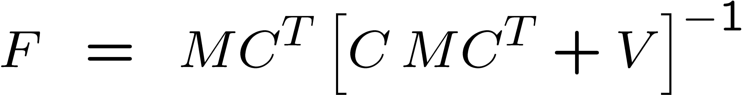
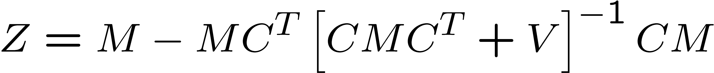
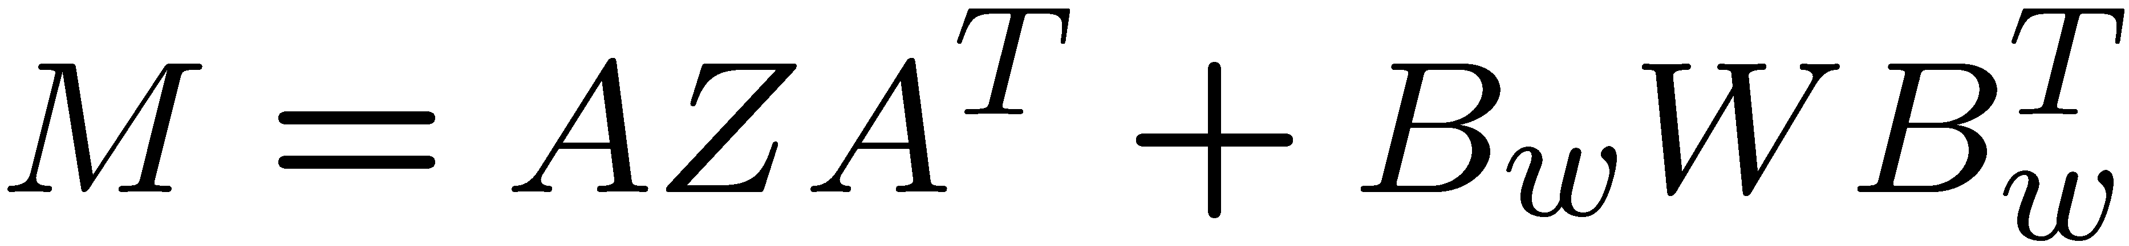
Stationary LQG
Optimal cost (derivation)
Note:
(least squares)

Slide 27


Stationary LQG
Optimal cost (derivation)
last term:
first term:

Slide 28

Stationary LQG
Optimal cost (derivation)

